Slide 1
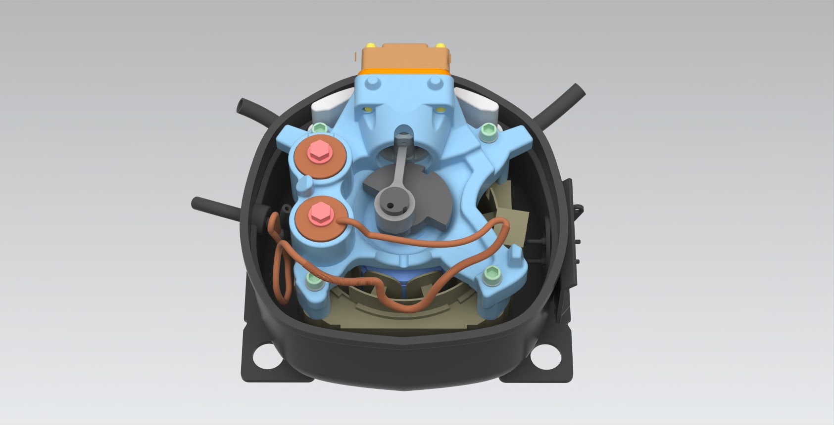
Mech 203 - Final Project
Group 4: Reciprocating Compressor
Kompresör?

Slide 2
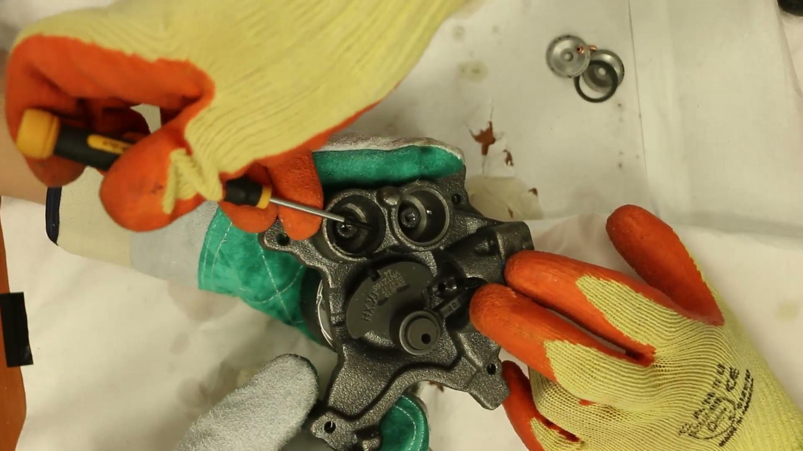
Reciprocating Compressor
One of the oldest compressor types, which is generally being used in refrigerators.
The working principle of these compressors are similar to combustion engines, where refrigerant is being compressed by a piston.
Contains a lot of part and are complex. These compressors are impossible to repair once the compressor is damaged.

Slide 3
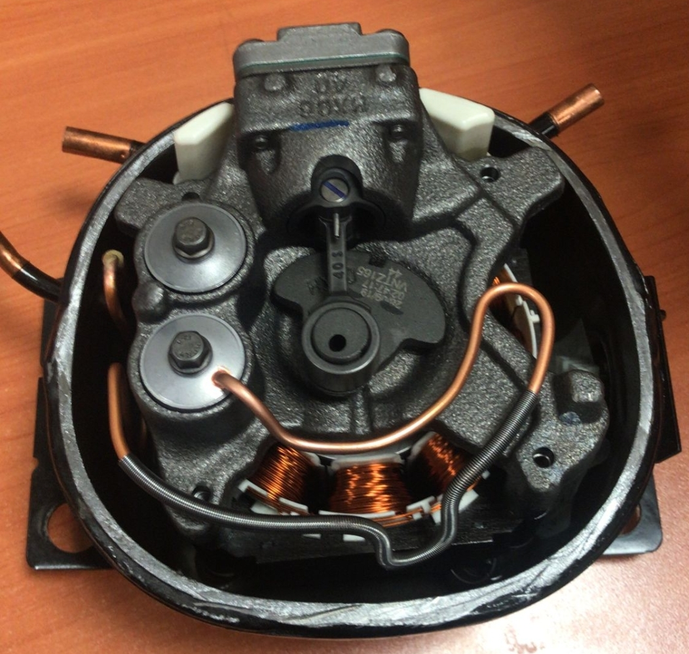
Specifications
3.70 kg Total weight
1300-4500 rpm
220 Volt - 60 to 225Hz
R600a (Flammable Gas)
Hermetic (Welded)

Slide 4
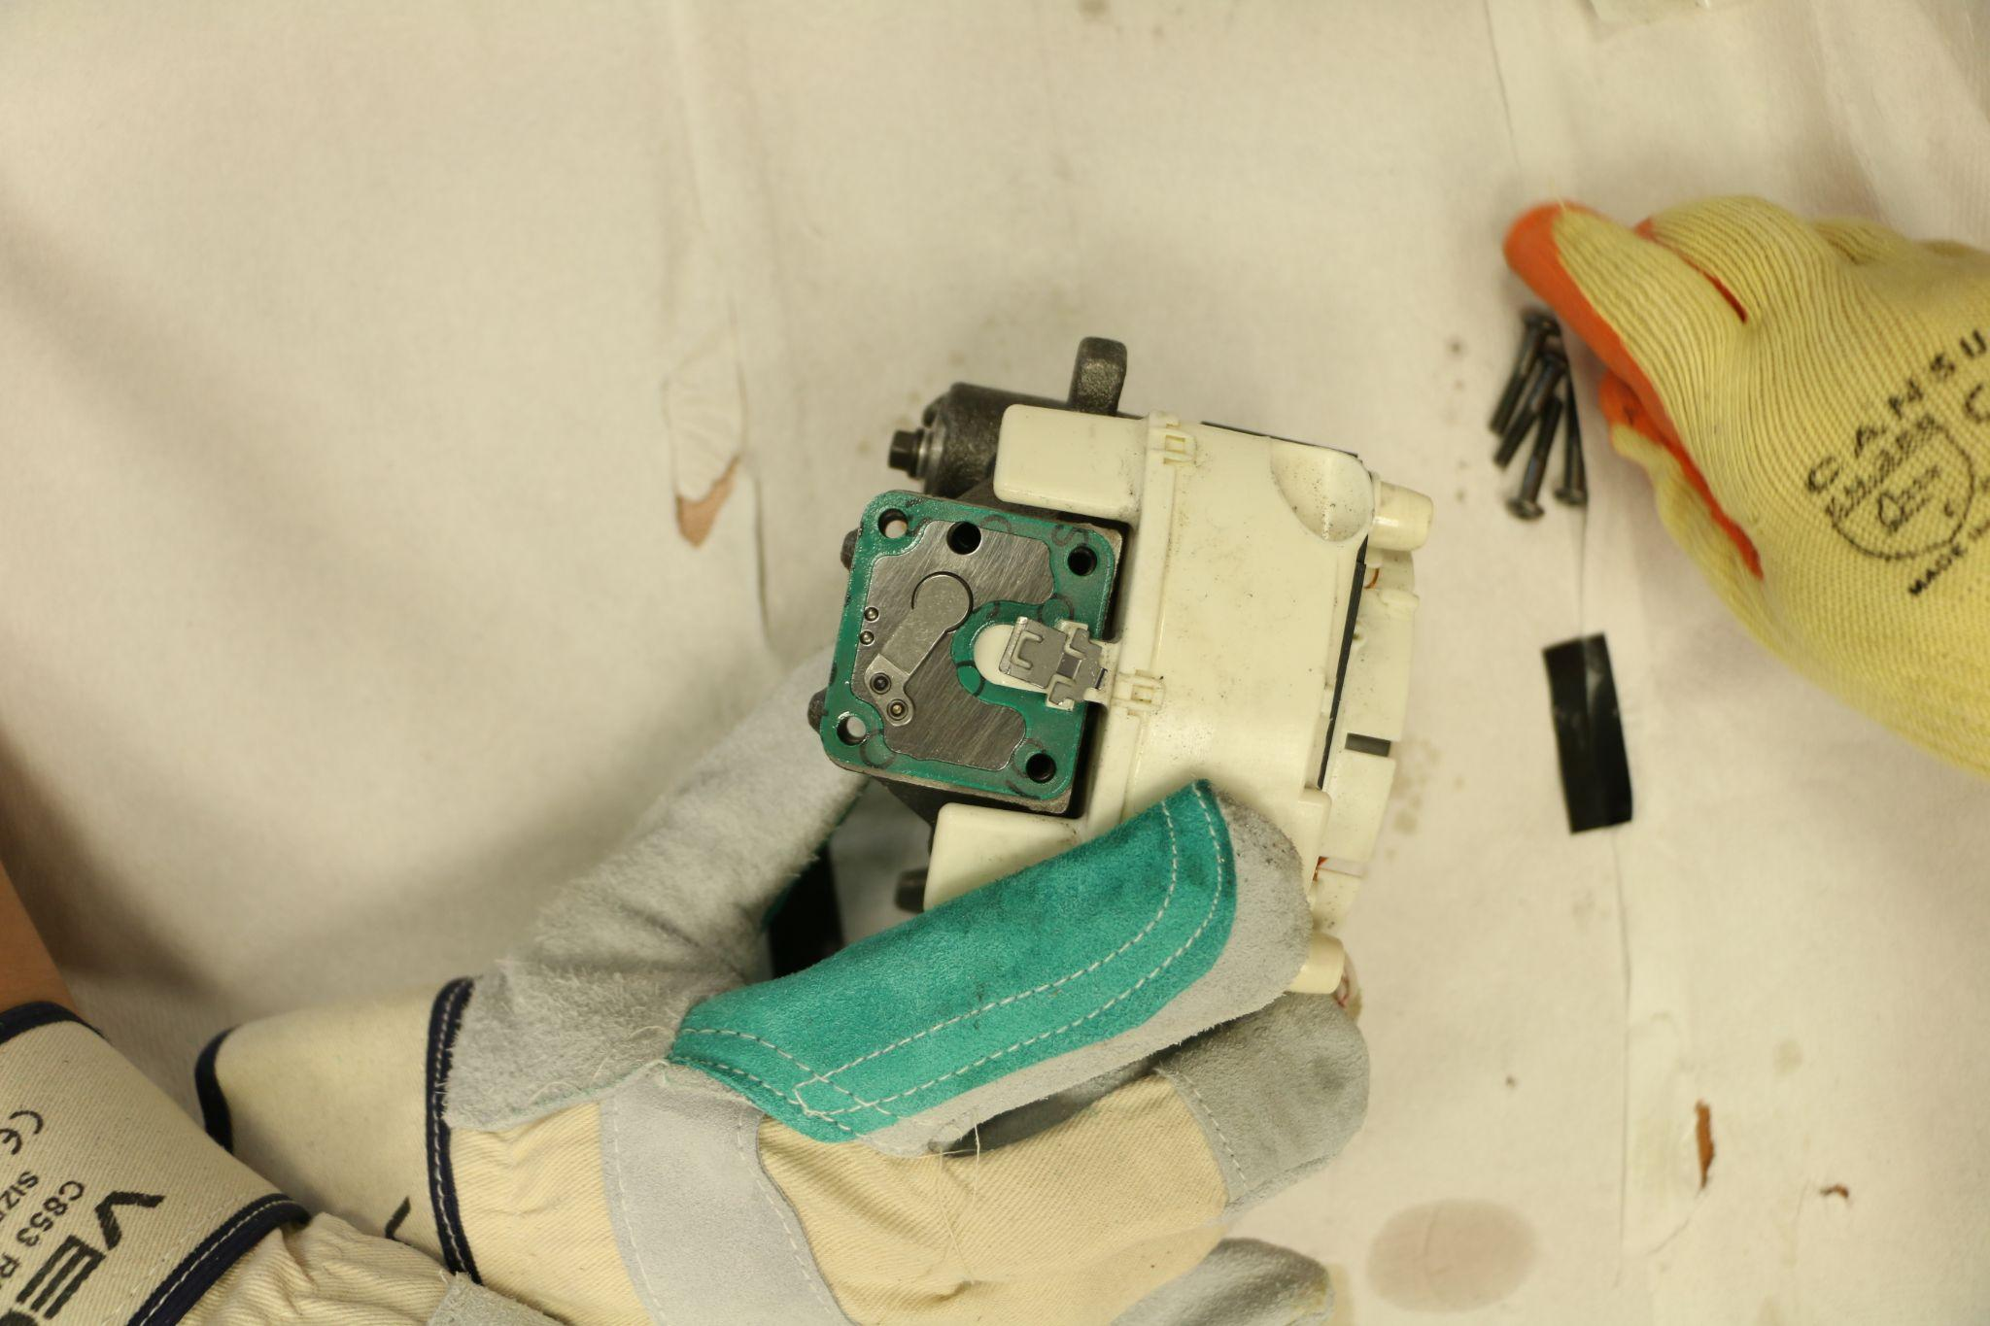
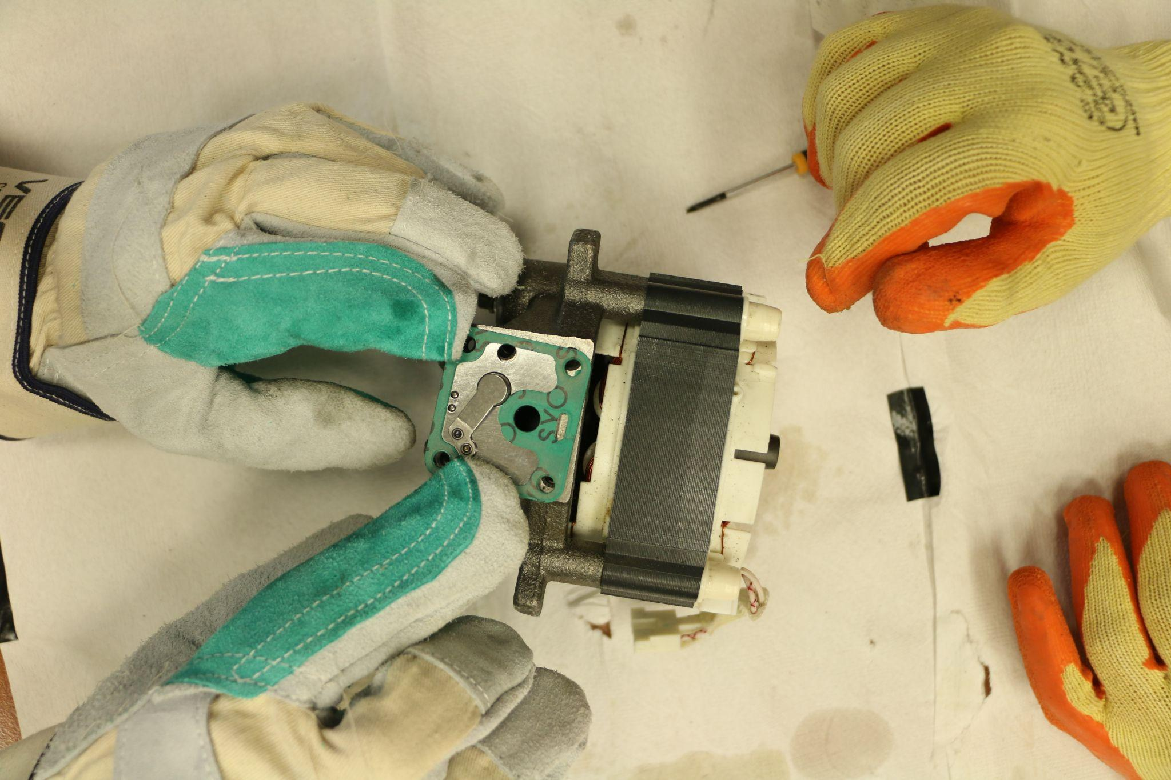
Parts and Disassembly
Number of parts: 35 unique 46 in total
How many hours: Around 20-80 per group member
Some of the challenges: Free form surfaces, tiny measurements, Measuring angles on non-uniform surfaces, disassembling interference fits
Notes:
Add video

Slide 5
New Functions of Siemens NX That We Learned
Sheet Metal Model and its features
Spline
Sweep Along Guide
Text
X-form
Helix
Thread
Swept
Notes:
Komutlari cizim bazli anlatim

Slide 6
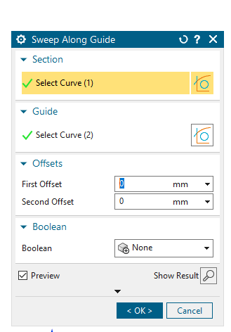
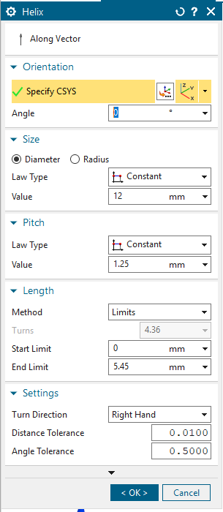
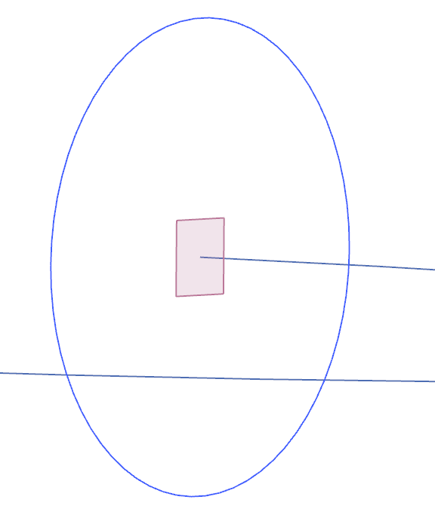
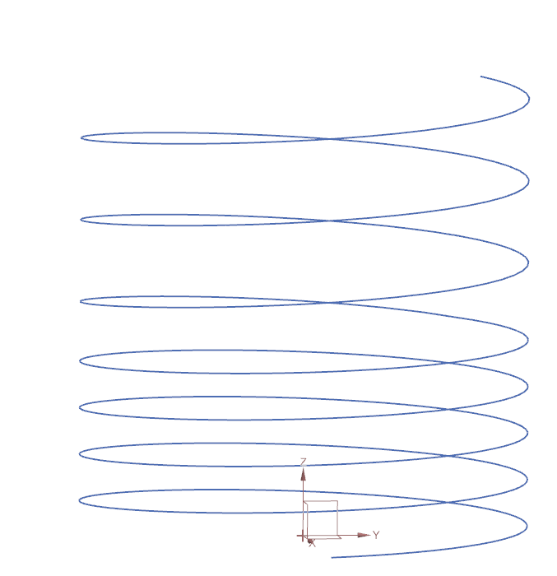
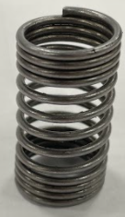
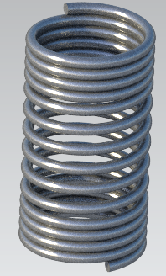
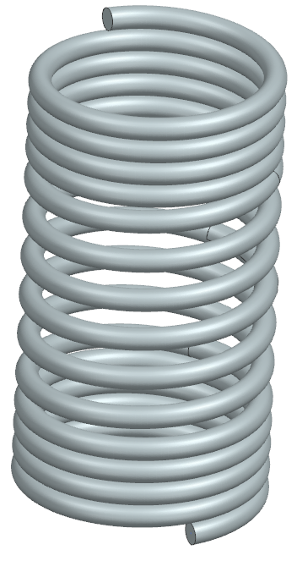
Helix & Sweep Along Guide

Slide 7
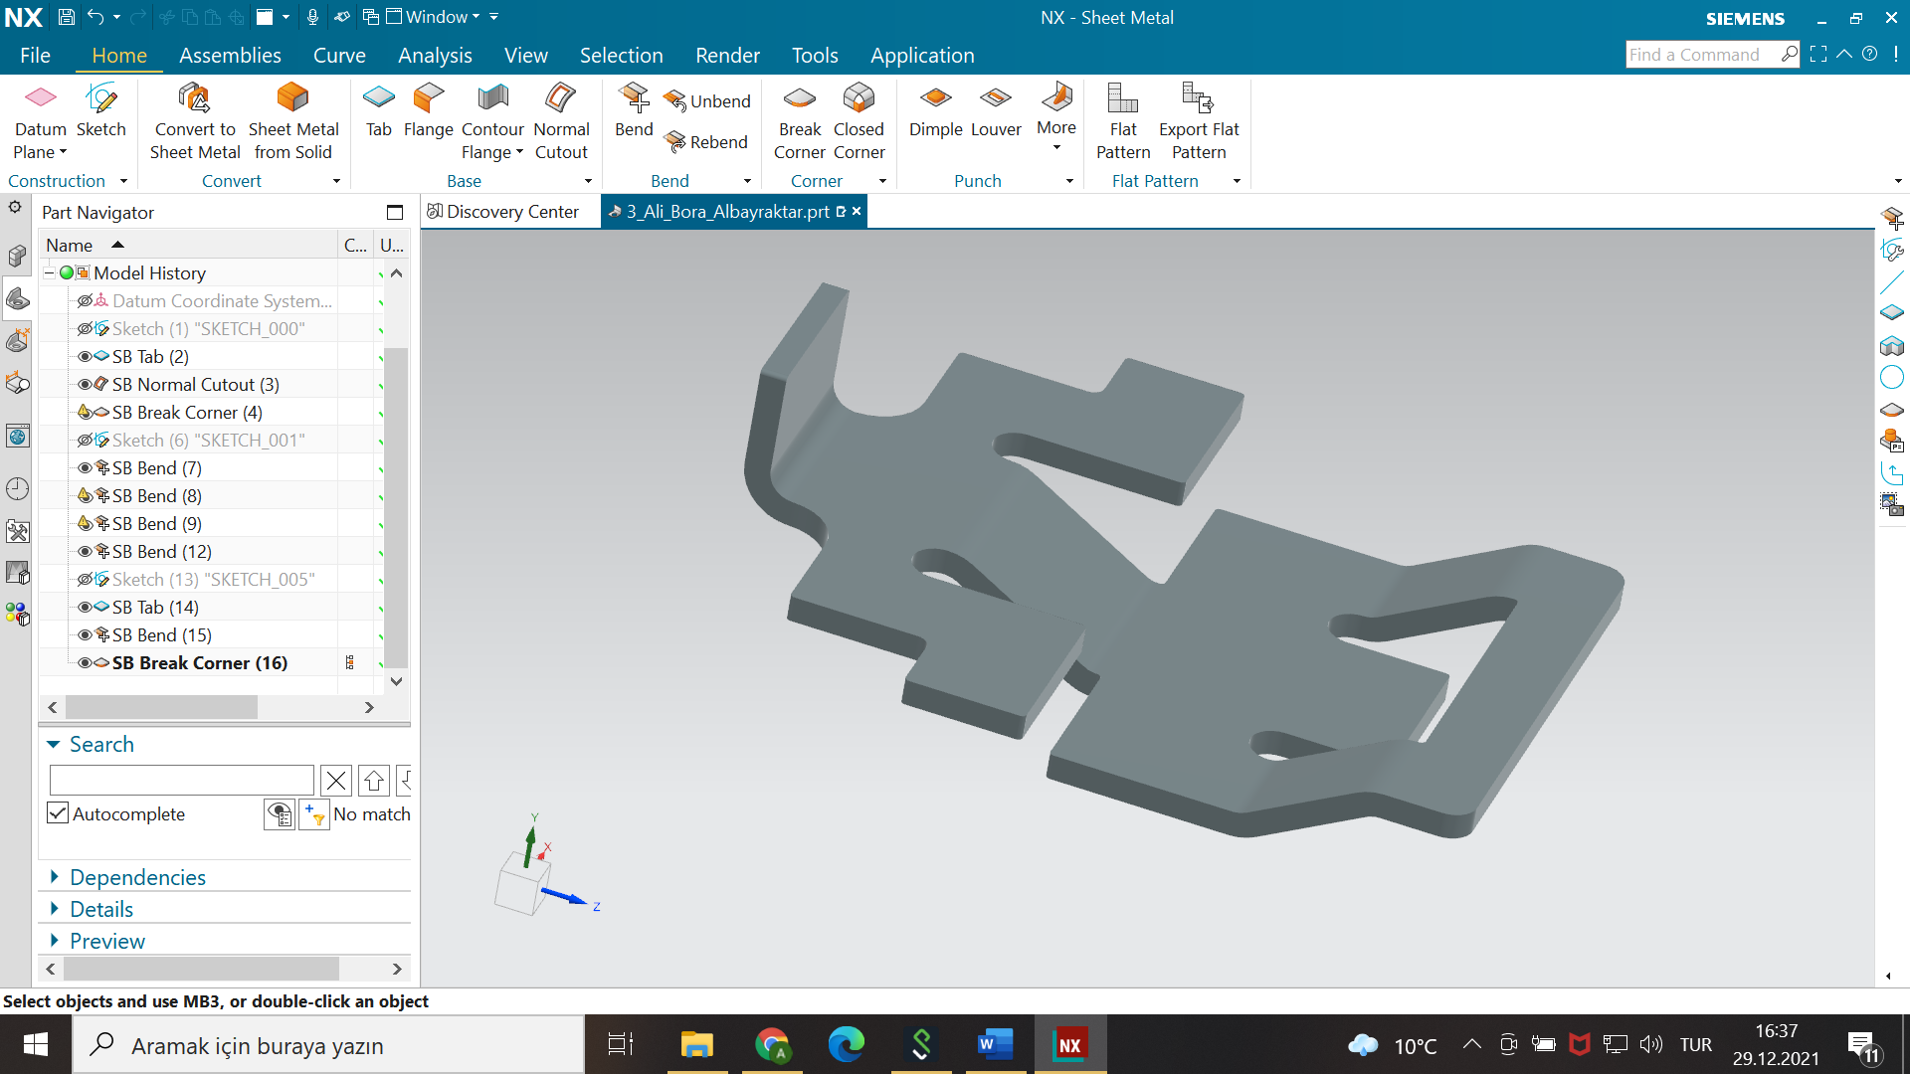
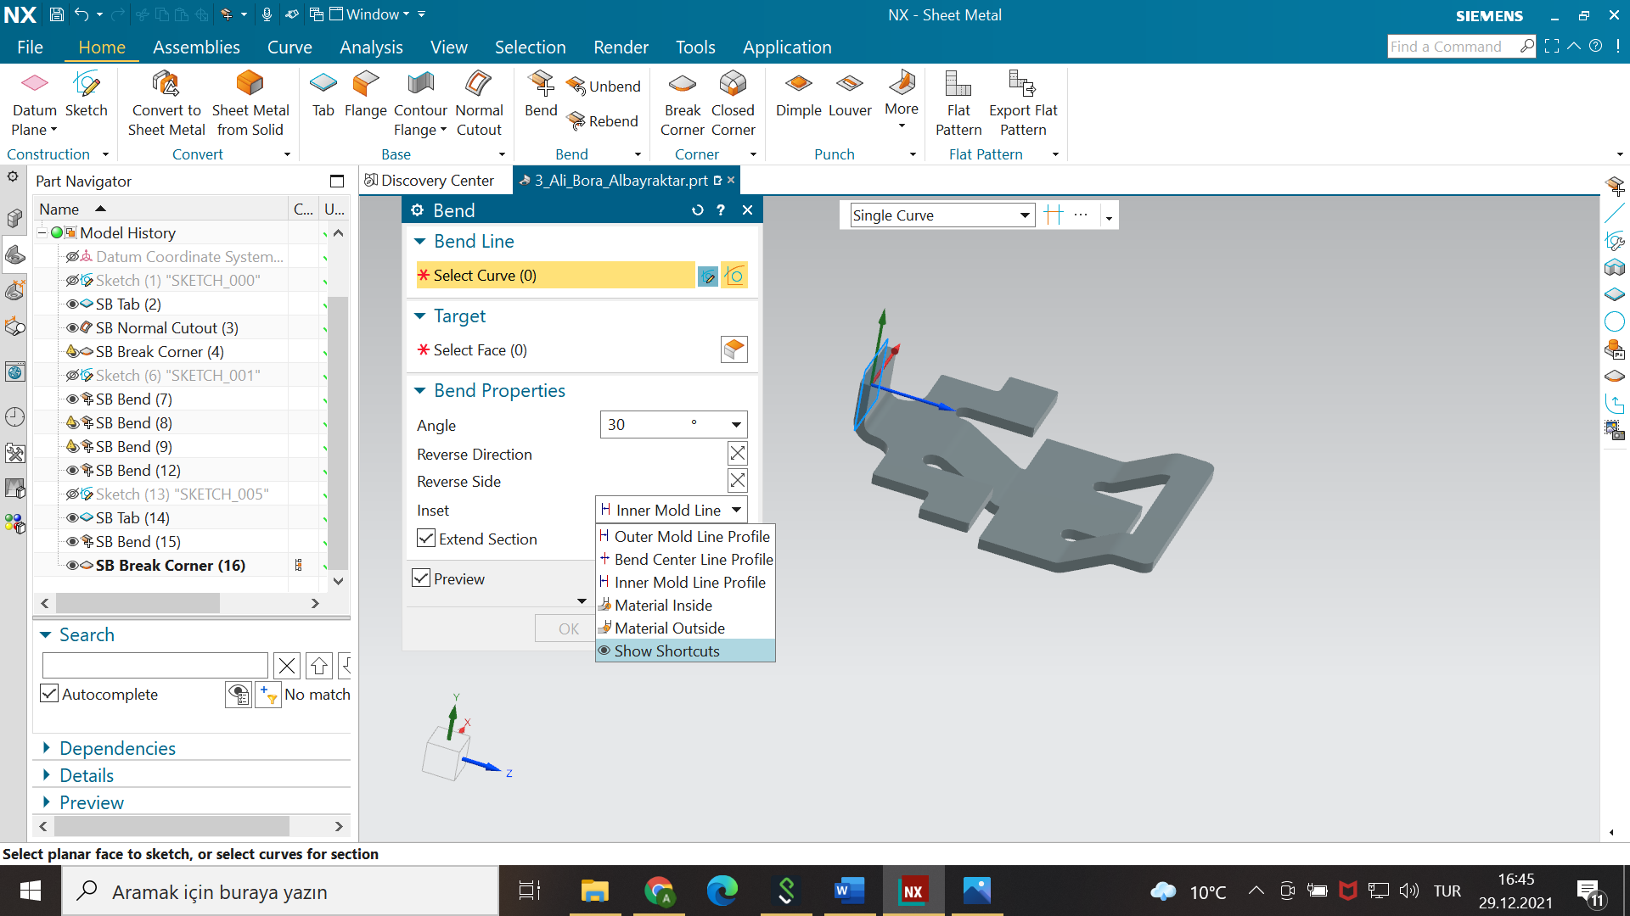
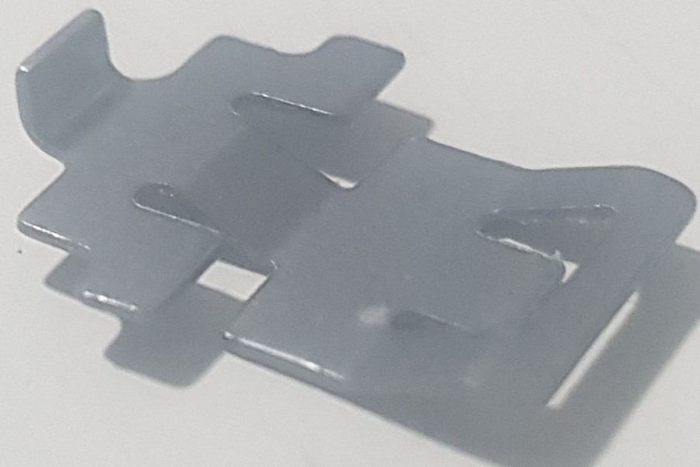
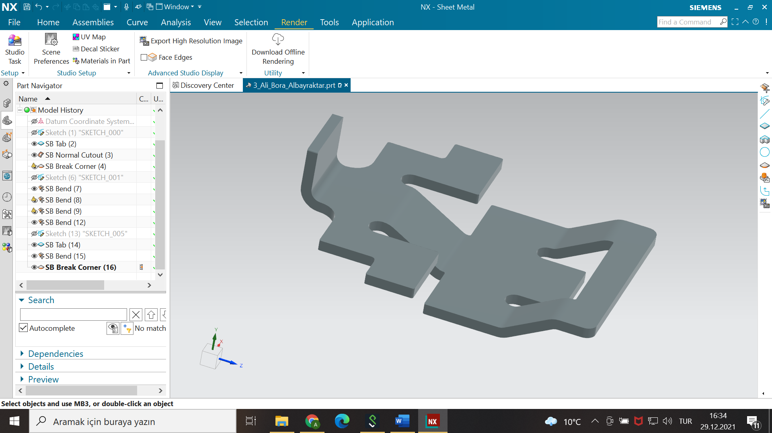
Sheet Metal

Slide 8
Parts List and Disassembly

Slide 9
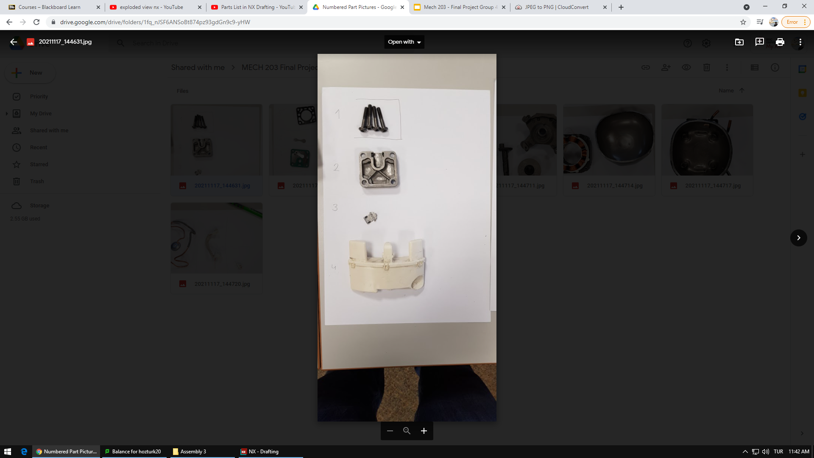
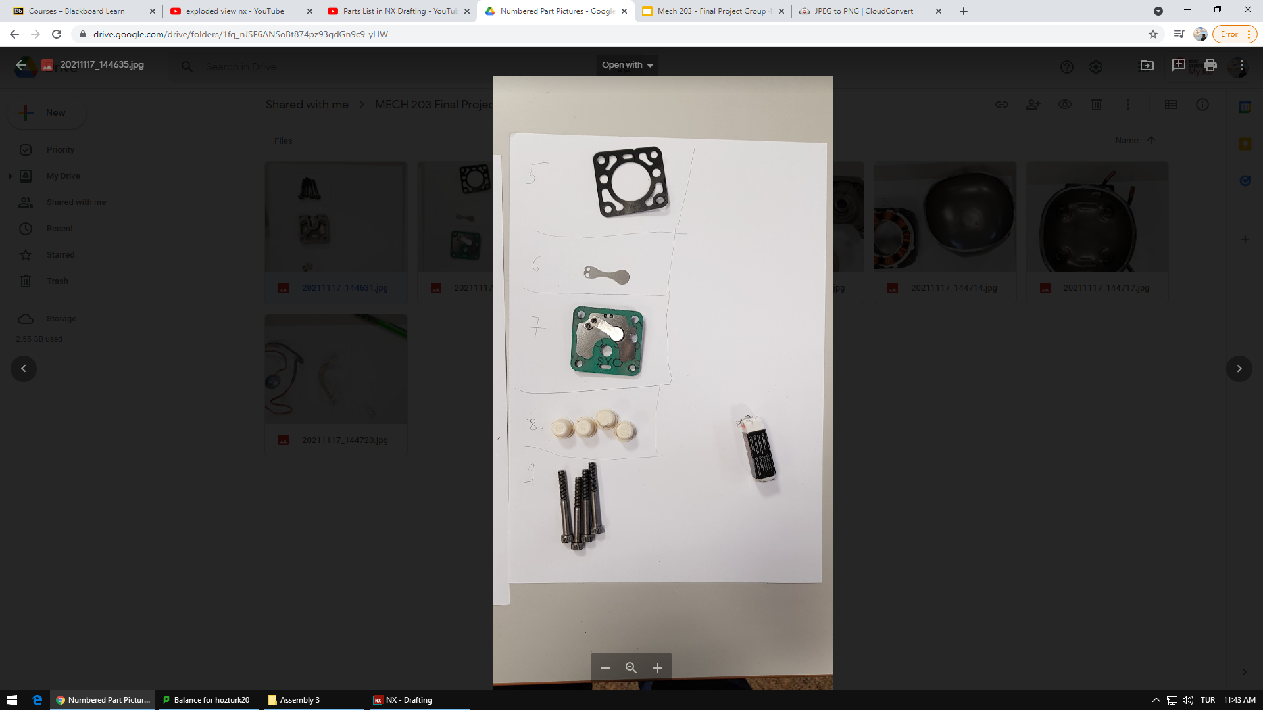
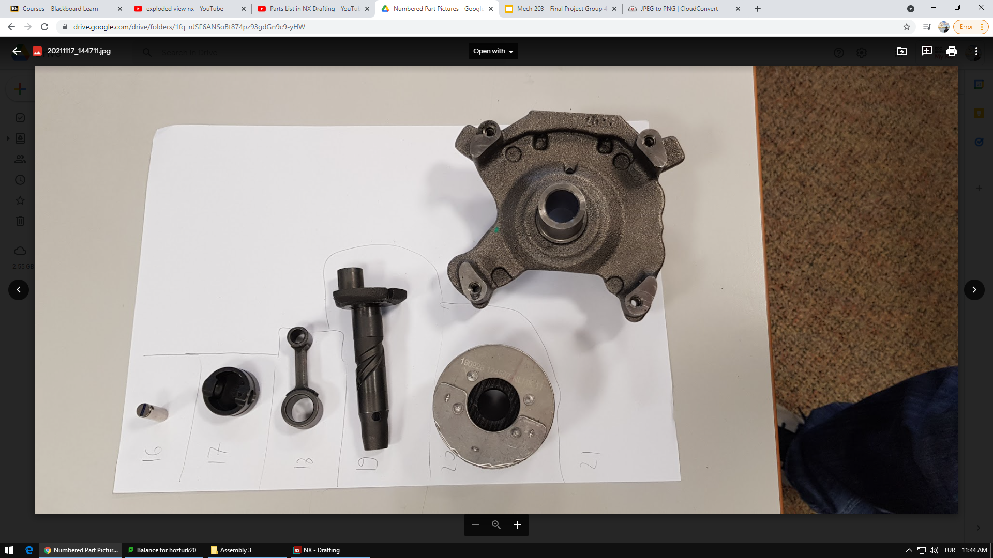
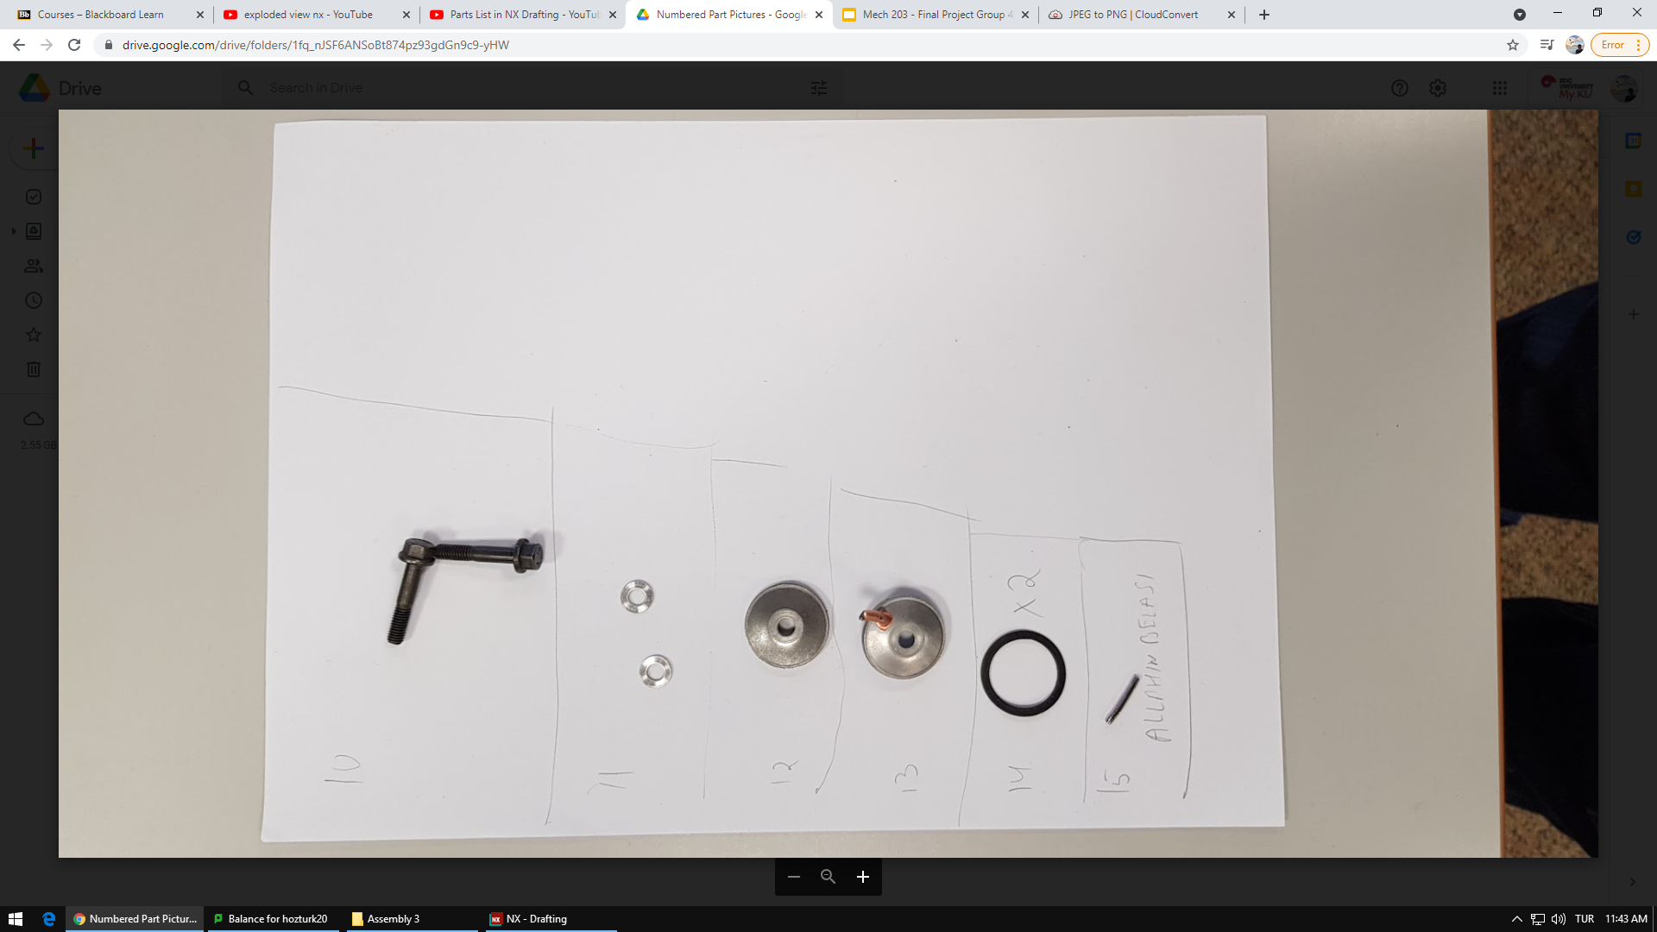

Slide 10
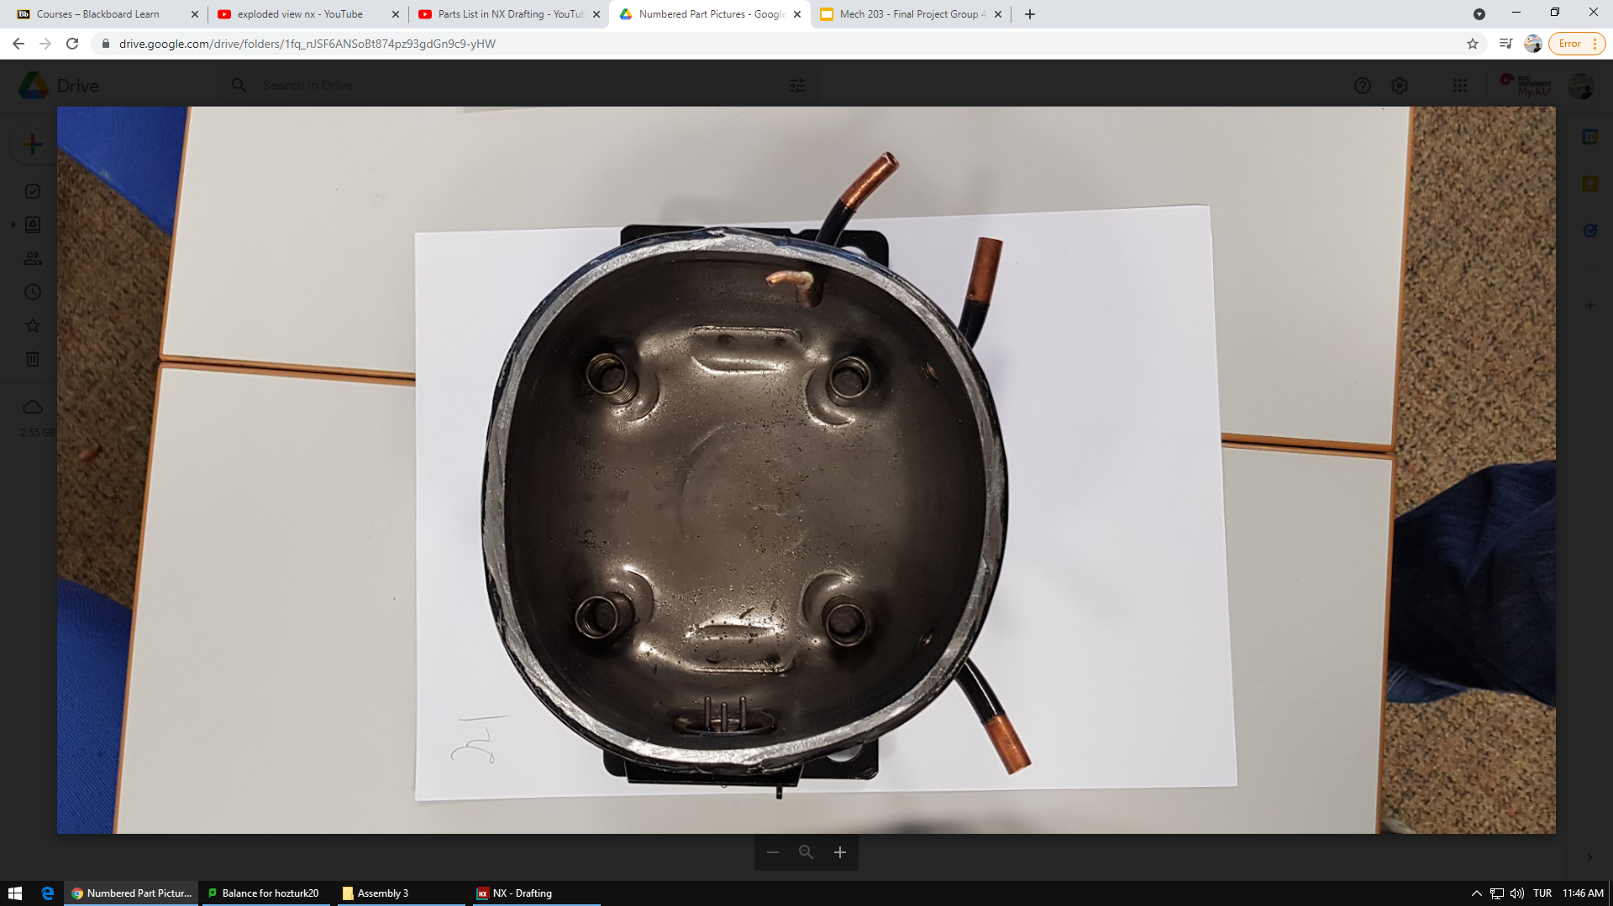
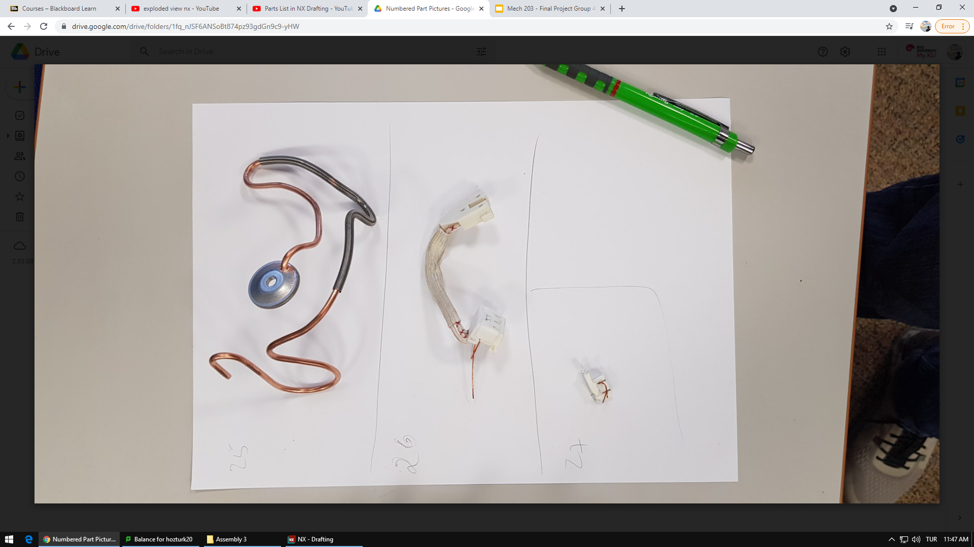
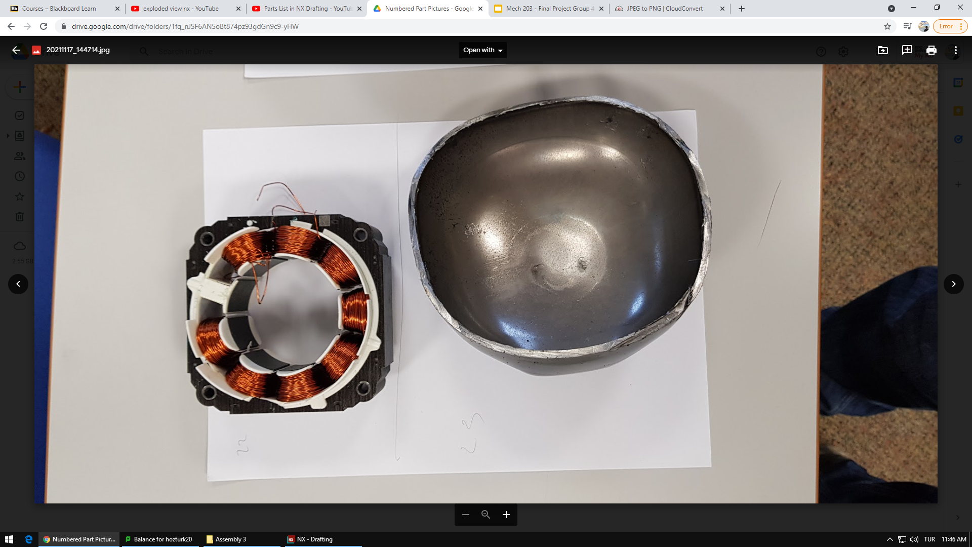

Slide 11
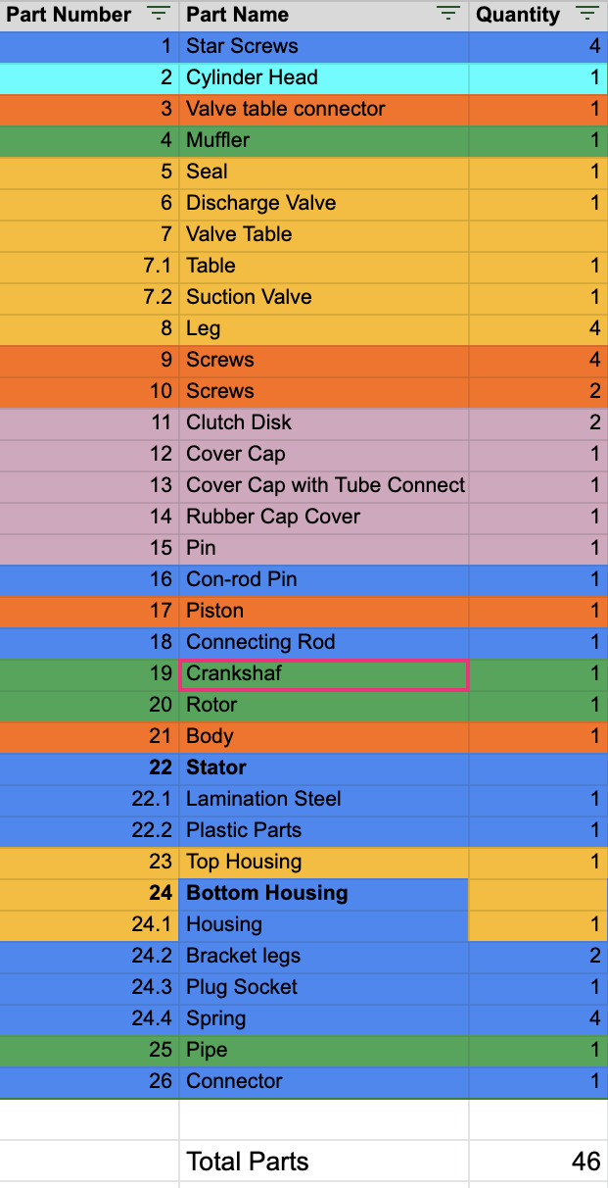
Parts List
Total: 46
Unique: 35

Slide 12
Assembly Sequence & Exploded Views

Slide 13
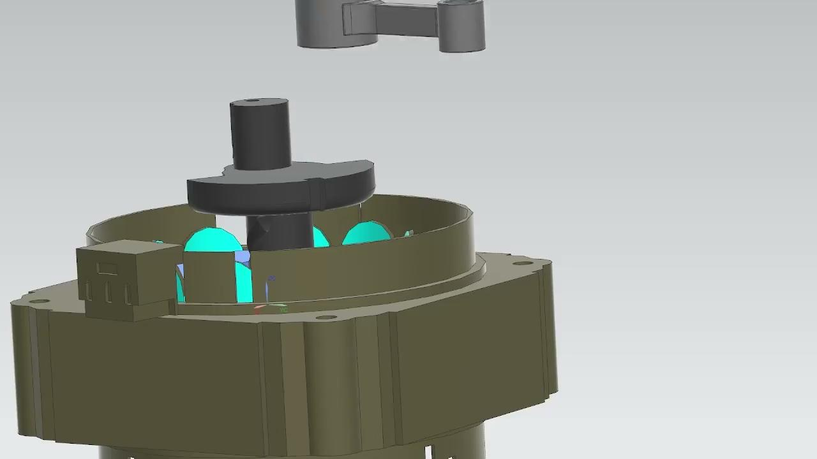
Assembly Sequence

Slide 14
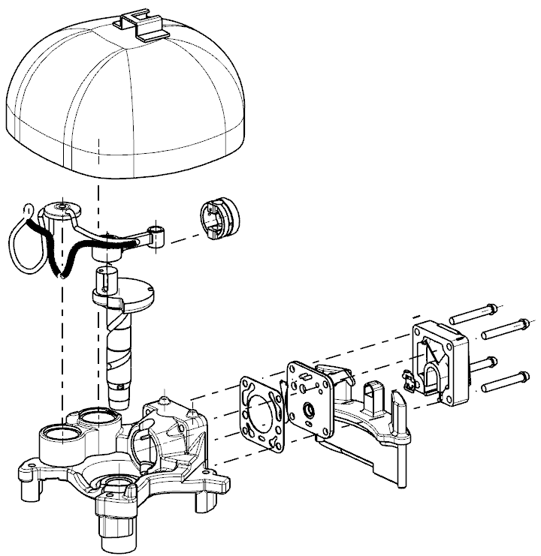
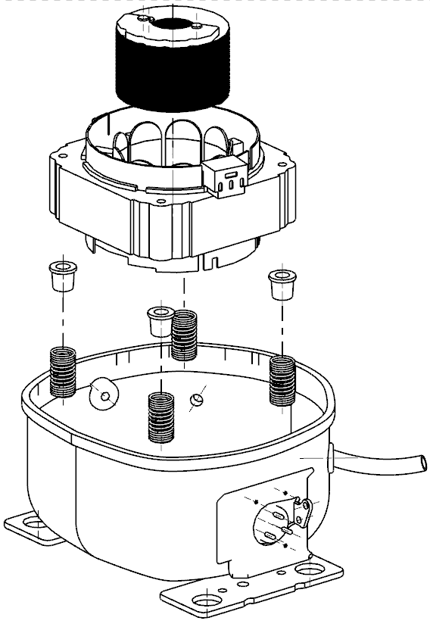
Top Housing
Rotor
Connecting Rod
Stator
Piston
Legs
Springs
Krankshaft
Muffler
Lower Housing
Body
Notes:
Add names + components

Slide 15
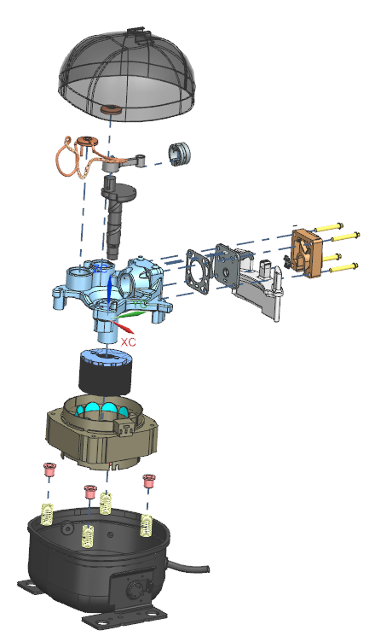
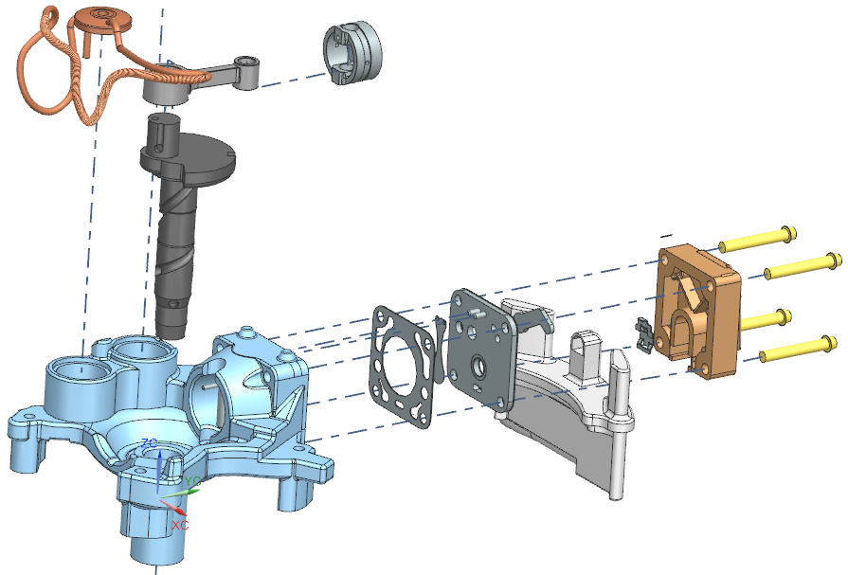
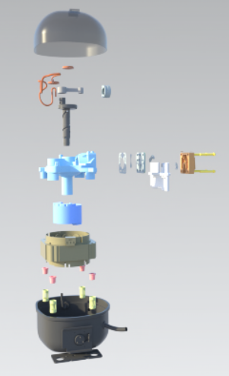

Slide 16
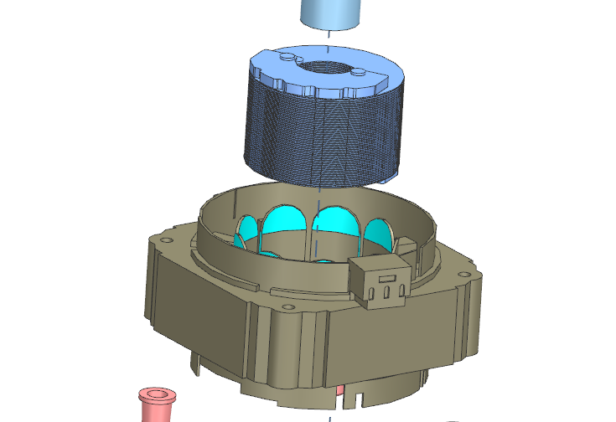
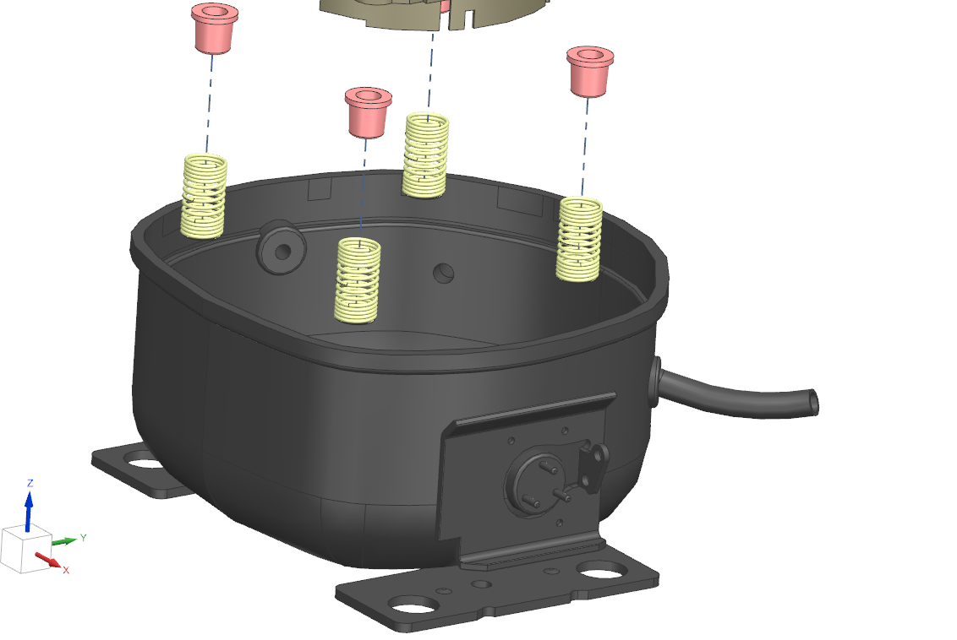

Slide 17
Part Comparisons

Slide 18
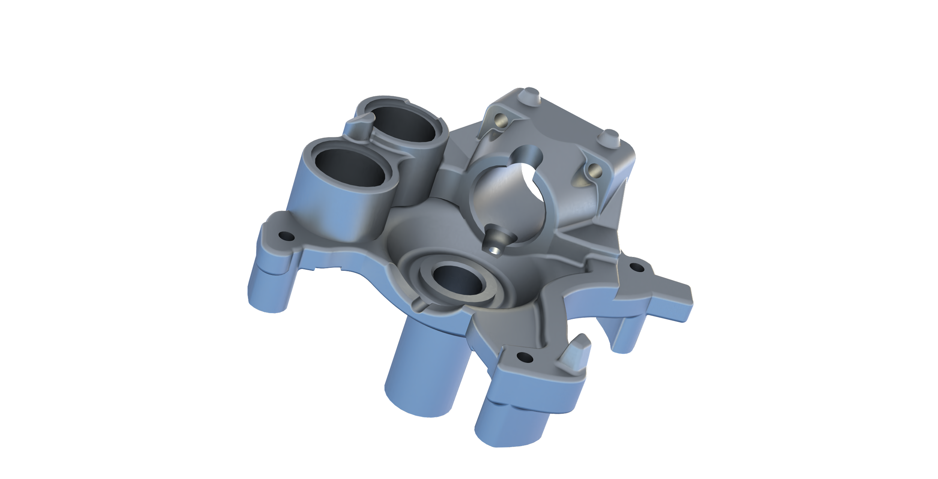
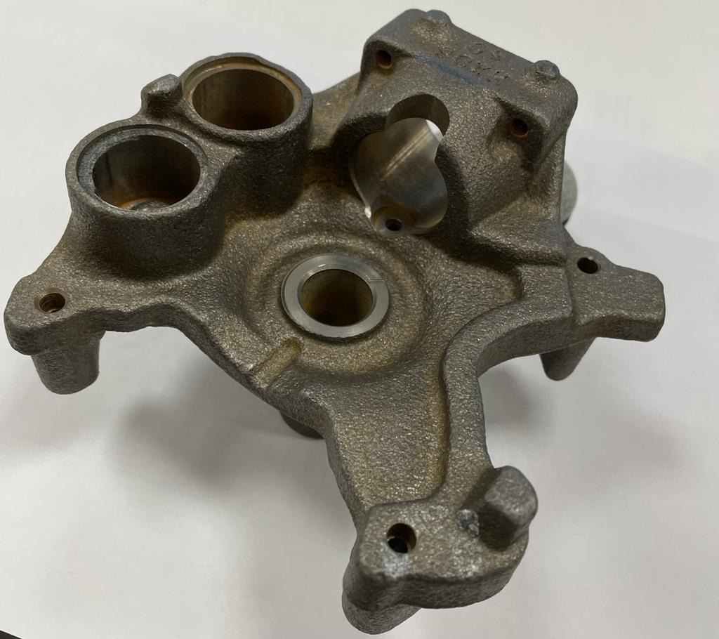
Part 1: Body (Gray Cast Iron)
Notes:
Render + add color

Slide 19
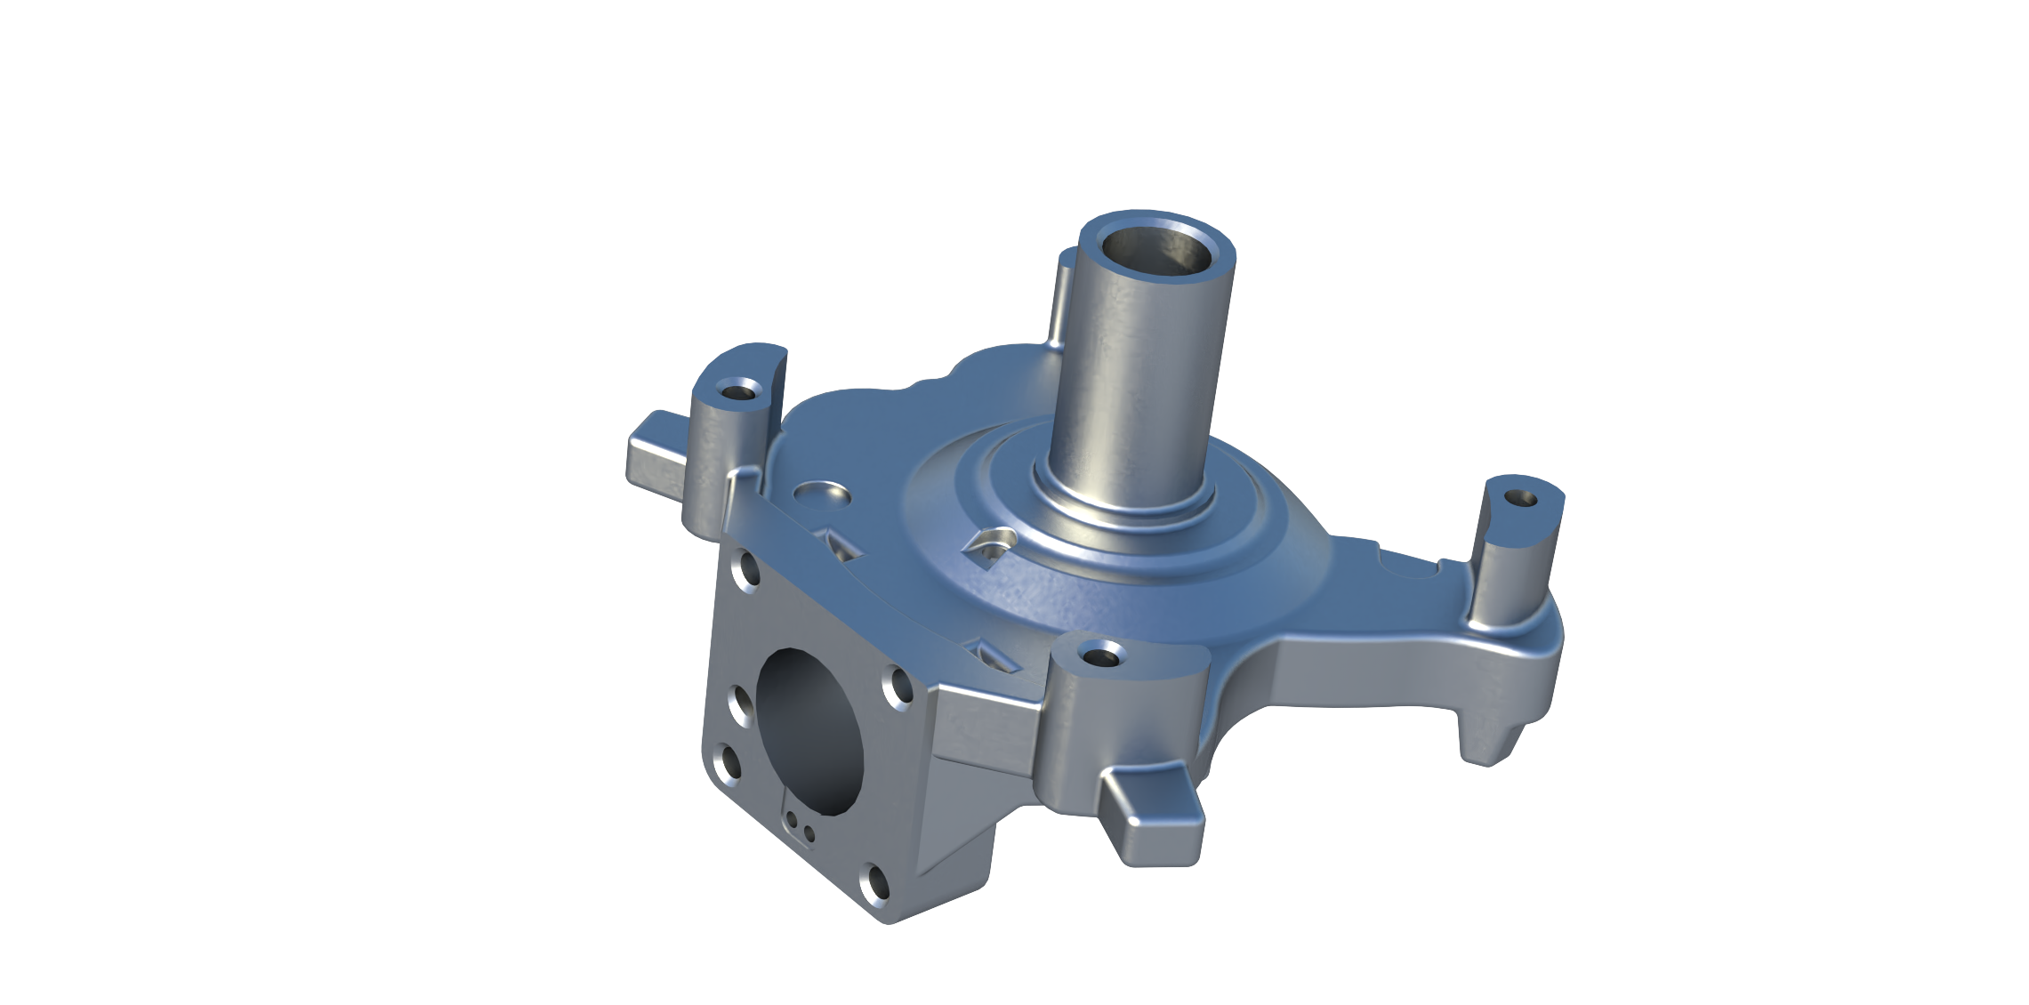
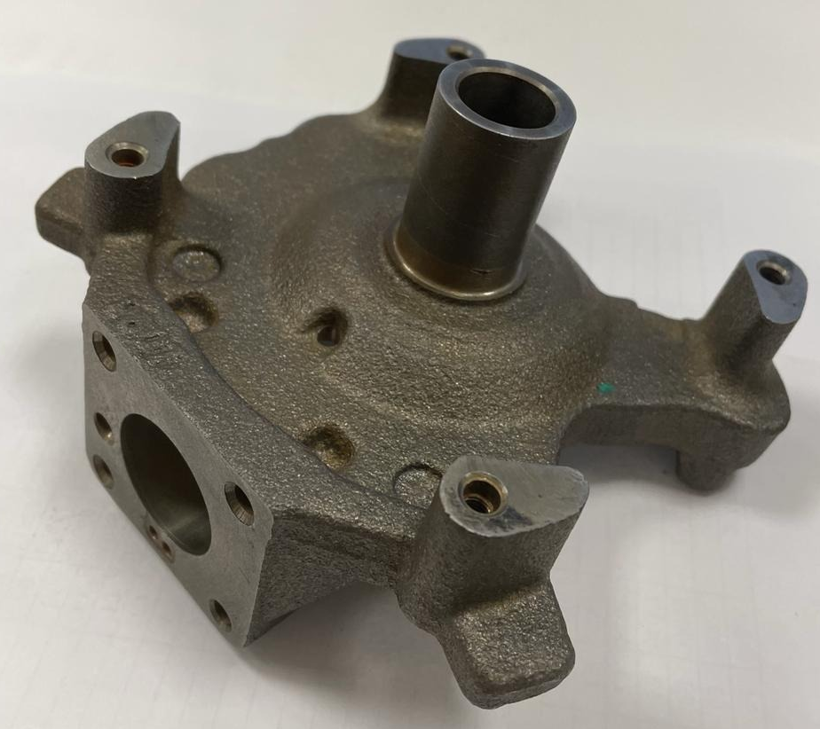
Part 1: Body (Gray Cast Iron)

Slide 20
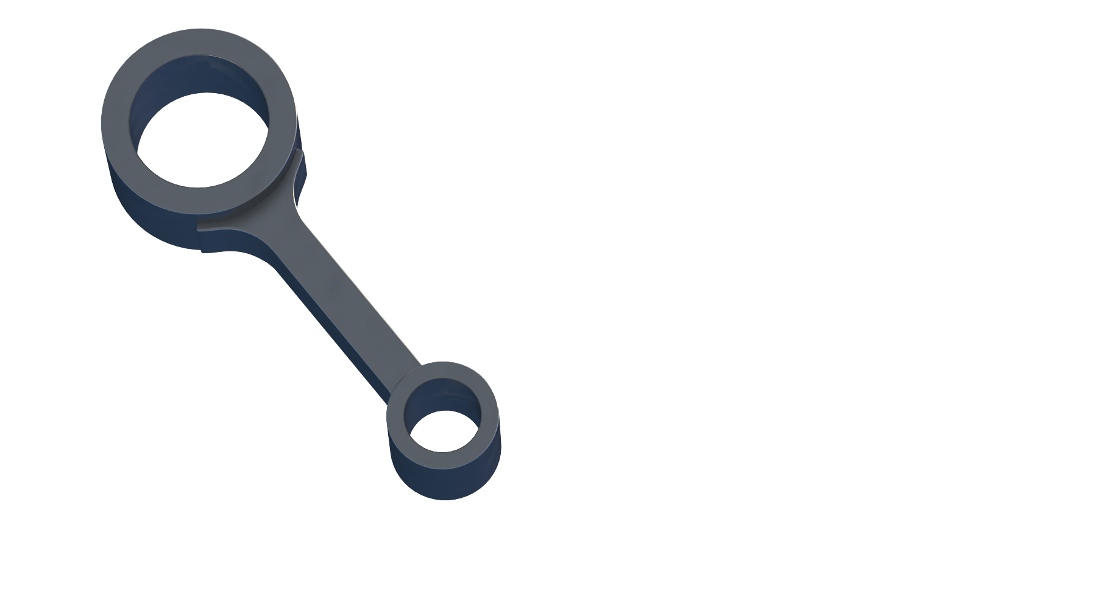
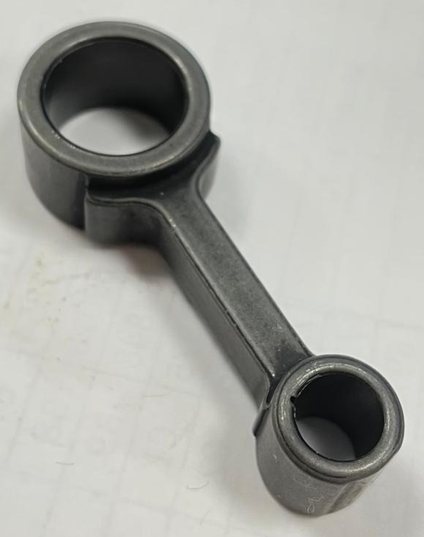
Part 2: Connecting Rod (Gray Cast Iron)

Slide 21
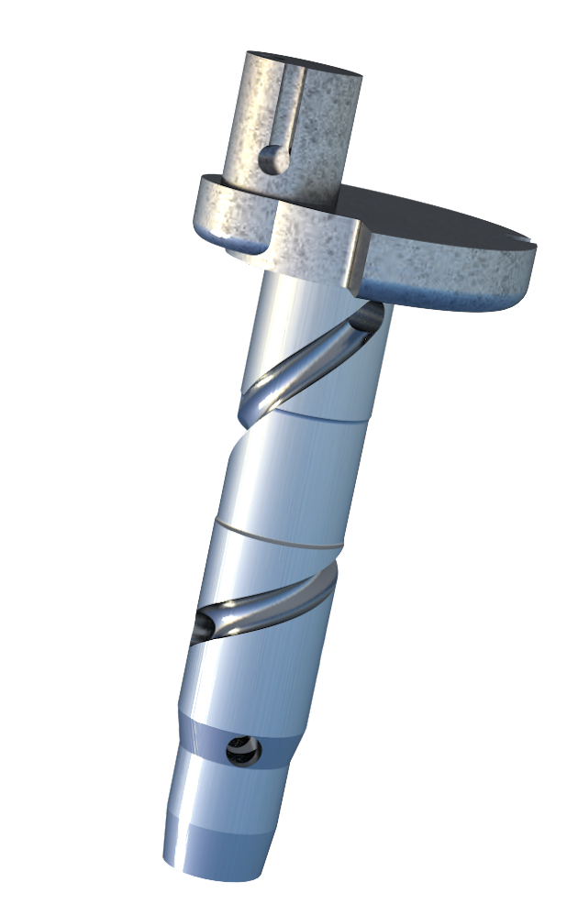
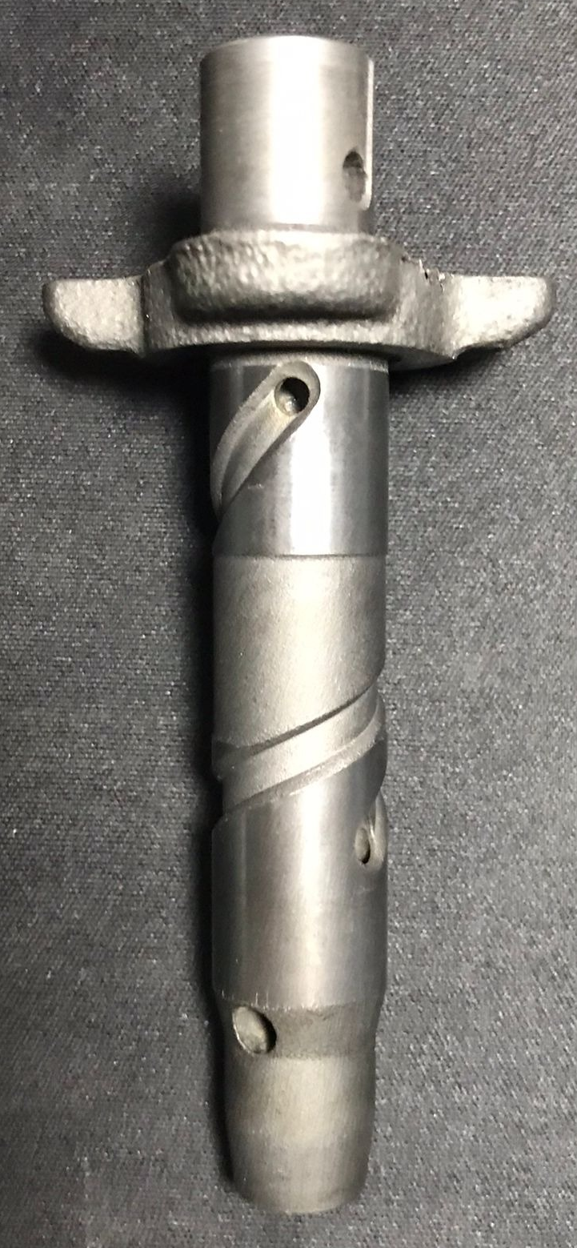
Part 3: Crank Shaft (Gray Cast Iron)

Slide 22
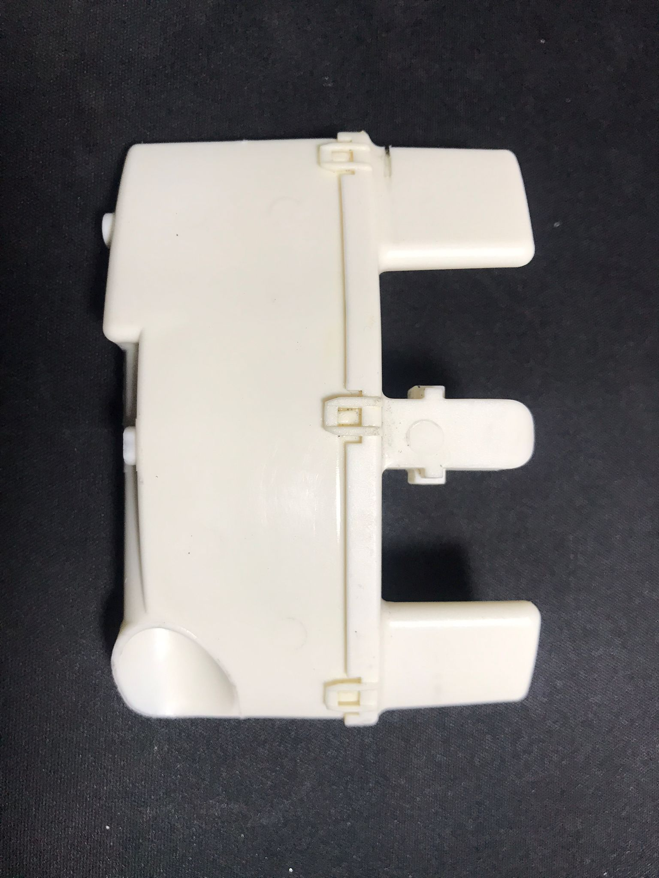
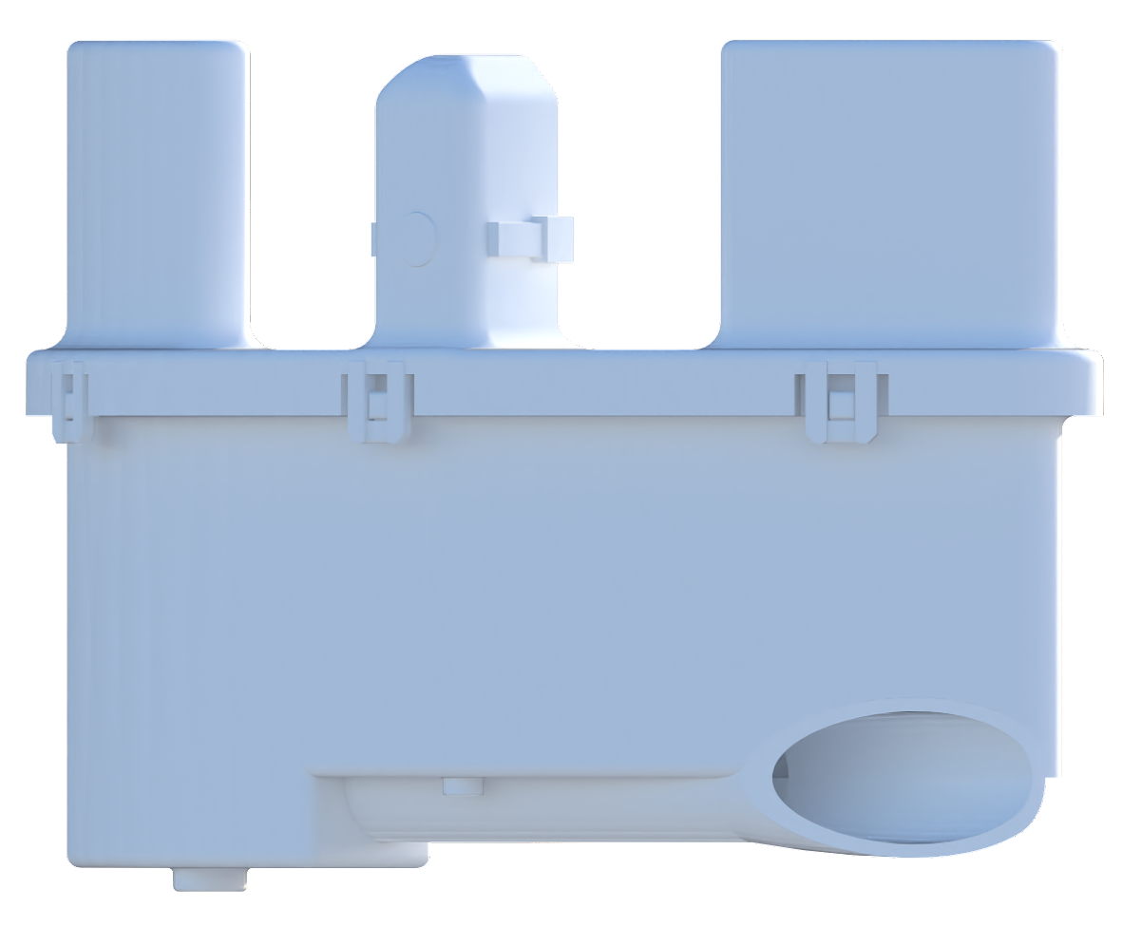
4) Muffler (PBT Plastic)

Slide 23
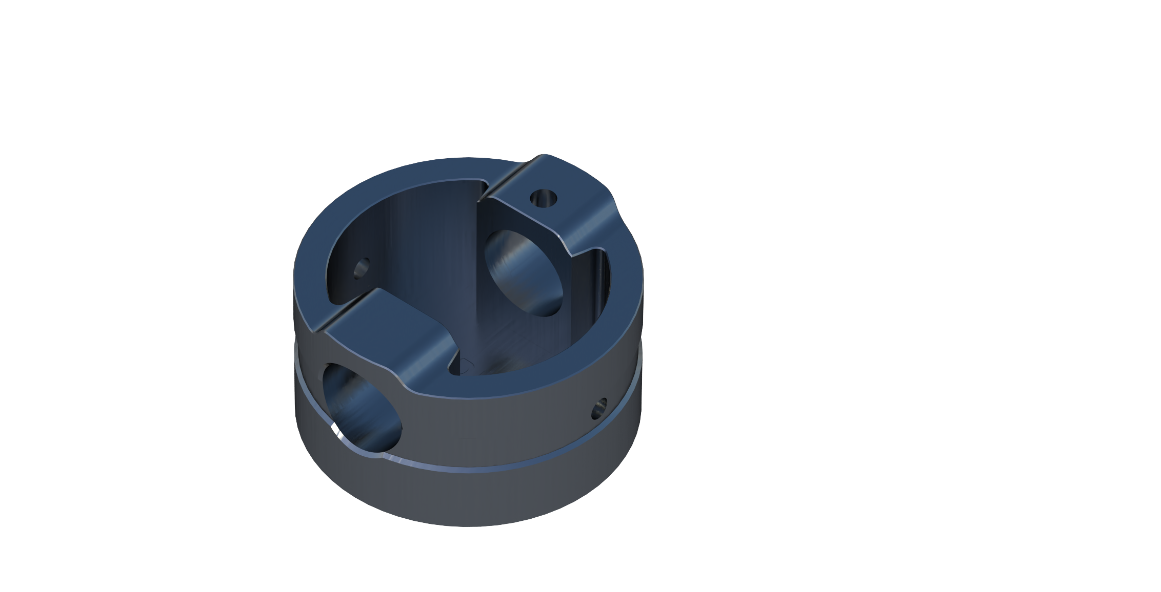
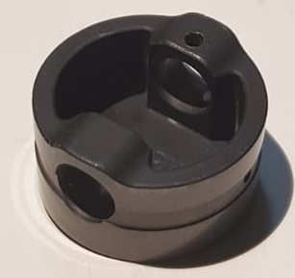
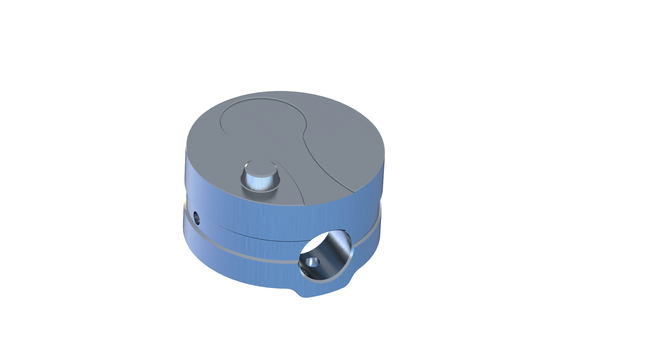
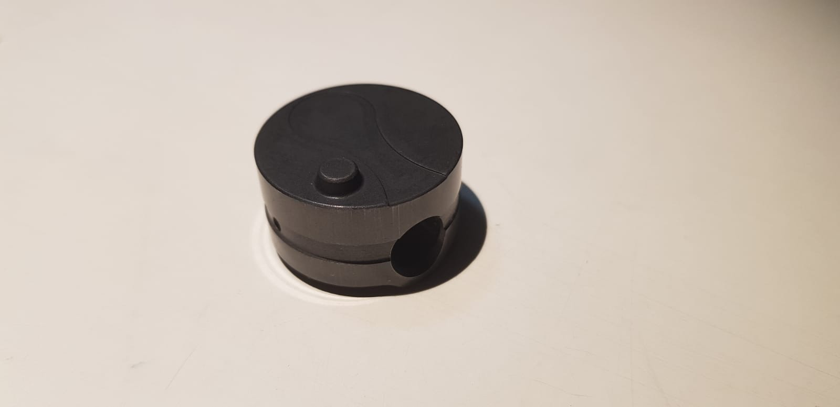
Part 5: Piston (Gray Cast Iron)
Notes:
Pistonlar ayni yere

Slide 24
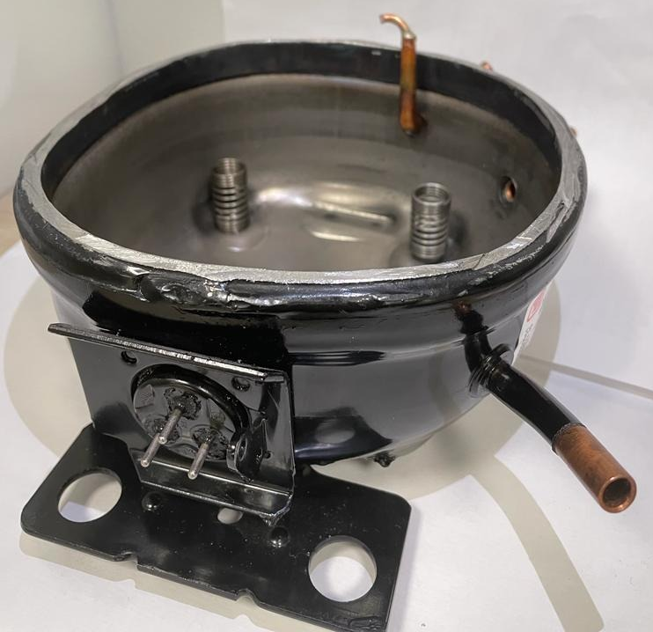
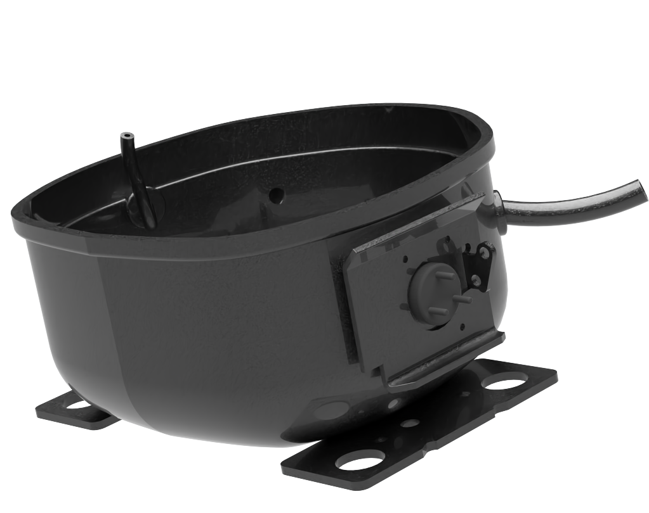
Part 6: Bottom Case (Sheet Metal)

Slide 25
Drafts and Drawings

Slide 26
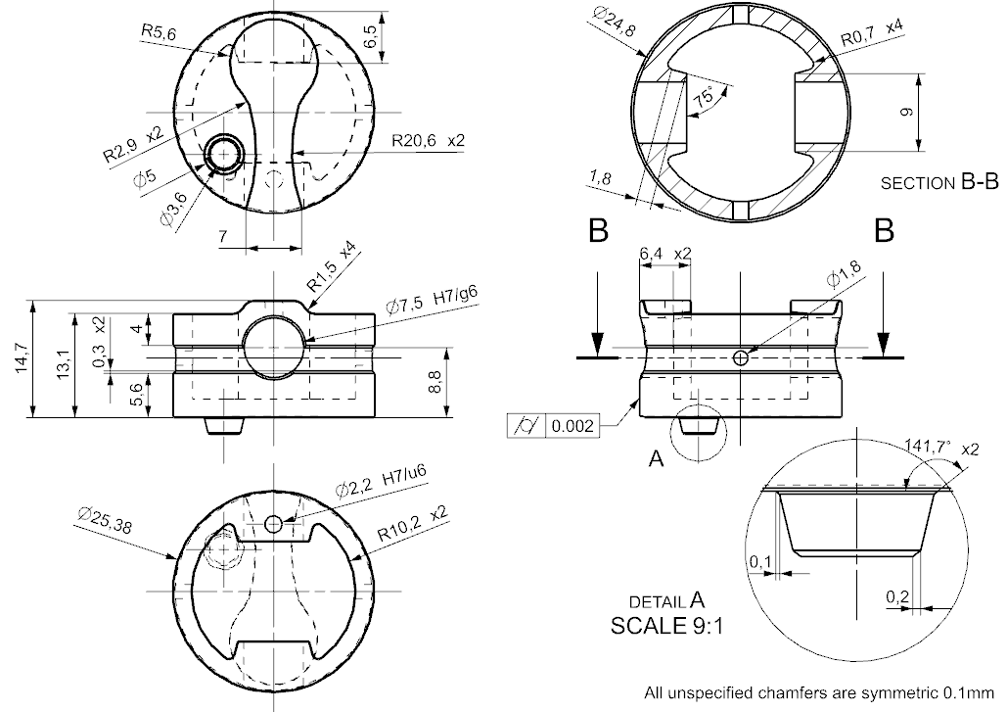
Piston

Slide 27
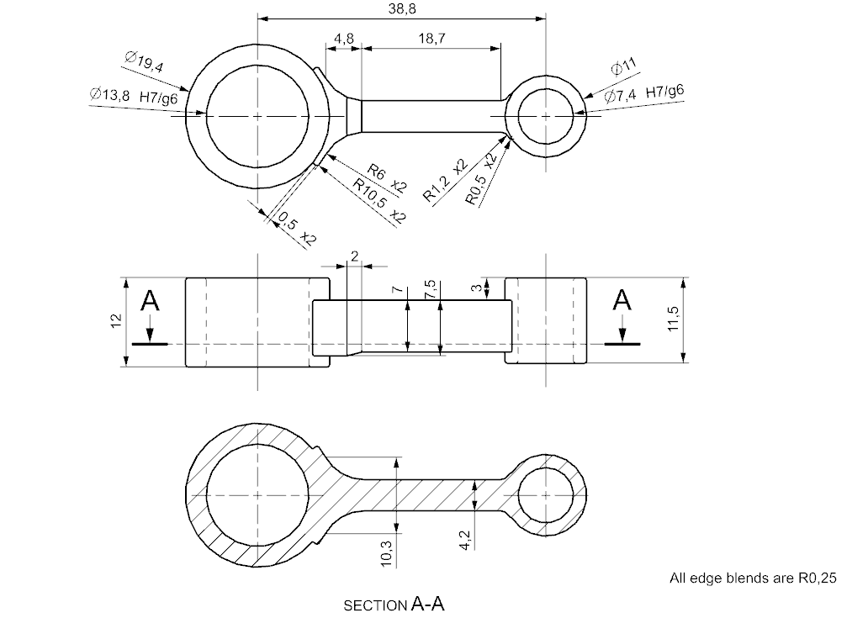
Connecting Rod

Slide 28

Lamination Sheet

Slide 29
Motion Simulation

Slide 30



Motion Simulation
Discharge Valve
Inner pipe
Suction Valve

Slide 31
Finite Element Analysis

Slide 32
Finite Element Analysis of Stress on the Piston
Materials (from Ansys library):
Gray Cast Iron
Boundary Conditions:
Pressure: 0.8 MPa
Fixed Support: The hole where pin connects

Slide 33

Boundary Conditions
Fixed support applied to the holes where pin connects.
8 bar (0.8 MPa) pressure applied on the bottom of the piston.

Slide 34

Mesh
Element Size: 10⁻³ m
Number of Nodes: 54148
Number of Elements: 34231

Slide 35



Results

Slide 36

Computational Fluid Dynamics (CFD) Analysis

Slide 37

CFD Analysis of Flow Inside the Pipe
A steady-state, laminar flow inside the pipe.
Materials (from Ansys library):
Fluid: air
Solid: 316L stainless steel
Boundary Conditions:
Pressure Inlet: 800 kPa
Mass Flow Outlet: 0.0273 g/s
Wall: No slip
Notes:
Ilk basa tasi

Slide 38

Mesh
Element Size: 6.679 mm
Number of Elements: 314908
Number of Nodes: 331945

Slide 39

Results
Pressure losses will decrease the efficiency of the refrigeration cycle.
Friction losses are present in every pipe, but bends in pipes may cause significant friction losses as well.
70 Pa lost in this case

Slide 40

Results
Total pressure loss:
781 Pa (0.097625 %)
The pipe is an effective vessel!

Slide 41
Thanks for listening!

